Slide 1
Secure Zero-Knowledge Password Manager with MFA
Presented By
Bavanapriya S – 23BIT0371
Eraiyamuthan P – 23BIT0306

Slide 2
Why is this project?
THE GAP
OUR IDEA
Today users:
Have many online accounts
Reuse the same passwords
Rely only on passwords for login
Problems:
Password leaks and data breaches
Weak passwords reused everywhere
Single login method is unsafe
If password is stolen, account will be lost
A Secure Password Manager that:
Stores passwords safely
Uses multiple authentication methods
Protects user privacy
Prevents unauthorized access

Slide 3
INTRODUCTION
01

Slide 4
Key Features
Secure User Registration and Login
Encrypted password storage
Email OTP verification
Face recognition login
Two-Factor Authentication (TOTP)
Encrypted password vault
Password Strength and Breach checking

Slide 5
SYSTEM COMPONENTS
FRONTEND
NODE.JS BACKEND
HTML/React.js
Handles Encryption and Decryption
Github Pages
Node.js
API Handling
Authentication Logic
HuggingFace Space
PYTHON BACKEND
DATABASE
Face Recognition using DeepFace
HuggingFace Space
MongoDB Atlas (Cloud)
Stores Encrypted Data Only

Slide 6
REGISTRATION FLOW
User enters Email and Password
Password is hashed (bcrypt – 12 rounds)
Email OTP is sent
OTP verification activates account
User account is created securely
NOTE:
Password is never stored
Only Hashed Value is stored

Slide 7
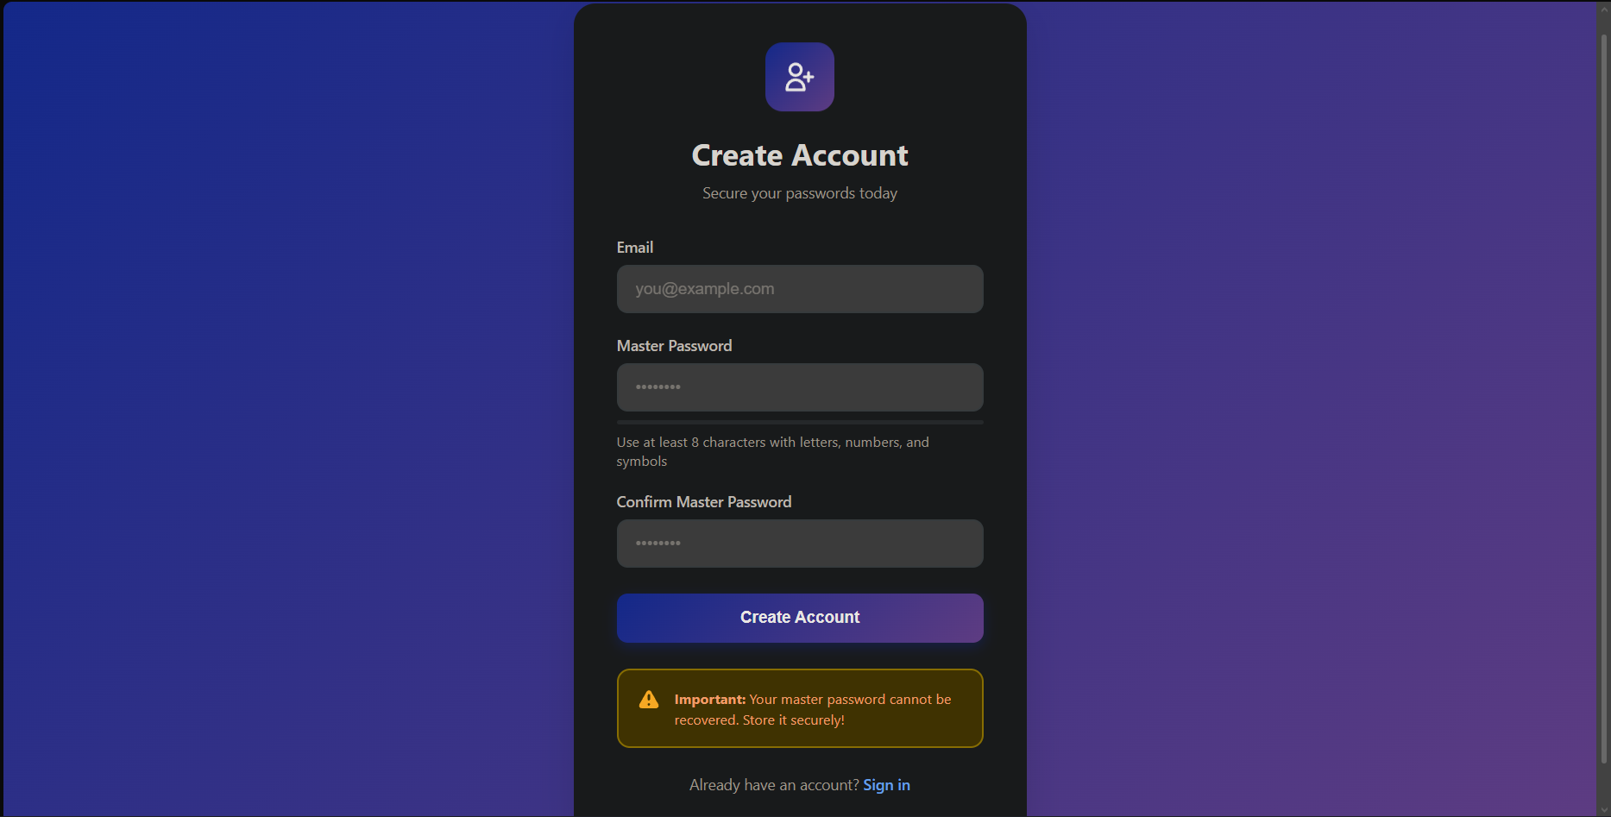
REGISTRATION PAGE
User enters Email and Password
Password is hashed (bcrypt – 12 rounds)
Email OTP is sent
OTP verification activates account
User account is created securely
NOTE:
Password is never stored
Only Hashed Value is stored

Slide 8
PASSWORD HASHING
Password
Random Salt
Password hashed using bcrypt
With Random Salt
Hash stored in Database
NOTE:
Server doesn’t know the Password
Protects against DB Leaks
Bcrypt – 12 rounds
Hashed Password

Slide 9
DERIVED KEY AND VAULT KEY
DERIVED KEY (256-bit) :
Derived from Master Password using PBKDF2
Generated inside the Frontend
Salt is stored in DB
VAULT KEY (256-bit) :
Key used to encrypt the password
Randomly Generated 256 bit key

Slide 10
DERIVED KEY AND VAULT KEY
Password
Salt
Vault Key
Derived Key
PBKDF2
AES-256
Derived Key
Encrypted Vault Key

Slide 11
DERIVED KEY AND VAULT KEY
STEPS:
User enters master password
Browser generates derived key
Derived key encrypts the vault key using AES-256
Encrypted vault key is stored in database
Server never sees real vault key
RESULT:
Only user can unlock vault
Server has no decryption ability

Slide 12
PASSWORD STORAGE FLOW
Username + Password
Vault Key
User adds a password
Password encrypted using vault key
Encrypted password sent to server
Server stores encrypted data only
Zero-Knowledge
Server cannot read passwords
Decryption happens only in browser
AES-256
Encrypted Data

Slide 13
LOGIN FLOW
User enters email & password
Password hash is compared and verified
OTP / Face / 2FA checked
User session is created
Access granted to vault

Slide 14
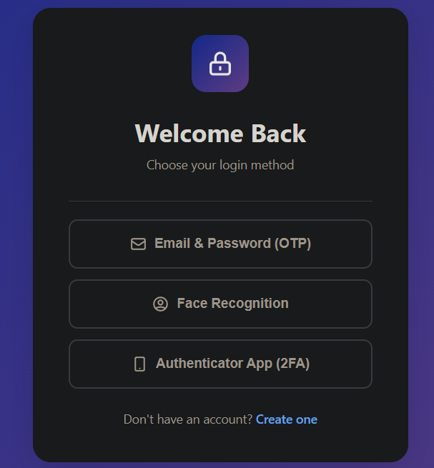
LOGIN OPTIONS
EMAIL WITH OTP
FACE RECOGNITION
AUTHENTICATOR
APP

Slide 15
MULTI-FACTOR AUTHENTICATION
02

Slide 16
EMAIL OTP AUTHENTICATION
STEPS
User enters email during registration or login
System generates a 6-digit OTP and sends to User’s Email
User enters OTP to verify
SECURITY MEASURES
Expires in 10 mins
OTP is hashed before storing
Limited attempts

Slide 17
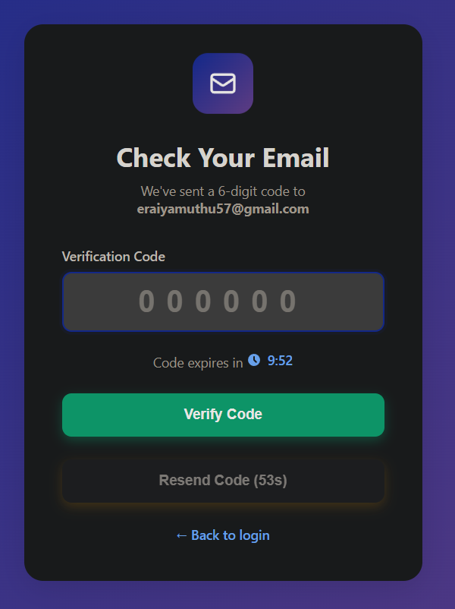
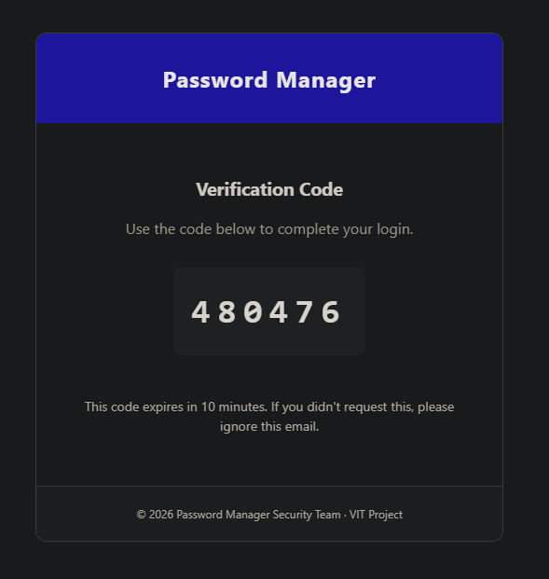
EMAIL OTP AUTHENTICATION

Slide 18
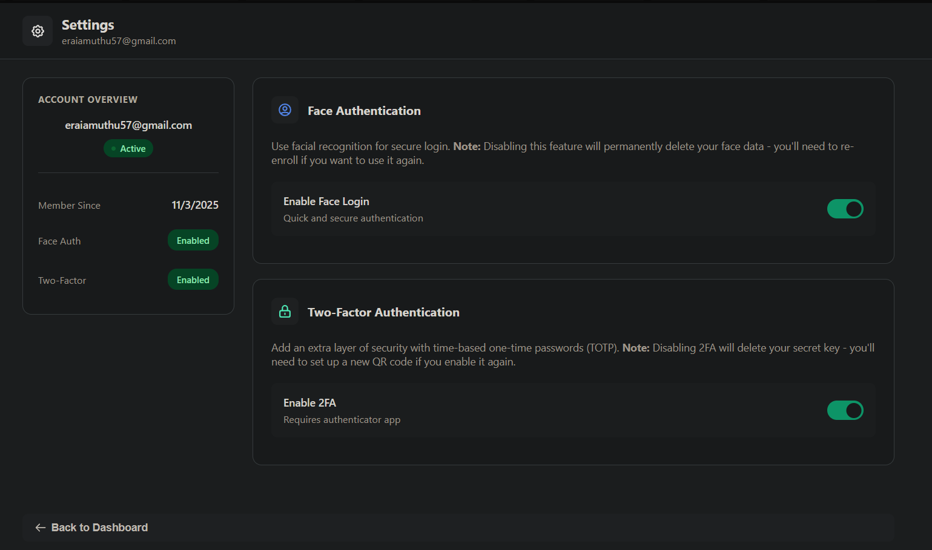

Slide 19
FACE AUTHENTICATION
Face Login
Webcam captures face
Face converted into numerical data
Numbers compared during login
If match, access allowed
Uses FaceNet512 embeddings for verification
Privacy
Face images are not stored
Only mathematical data is saved

Slide 20
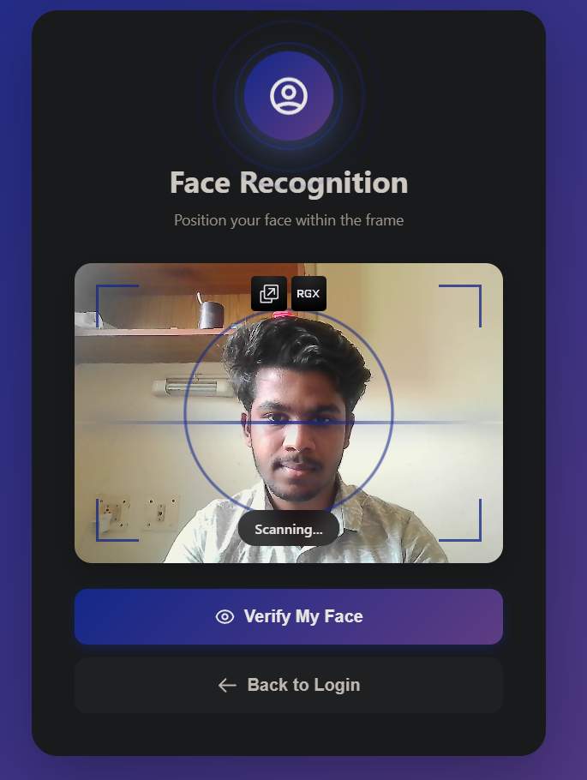
FACE AUTHENTICATION

Slide 21
TOTP AUTHENTICATION
Time-based OTP
Generated using authenticator app
Adds extra security layer

Slide 22
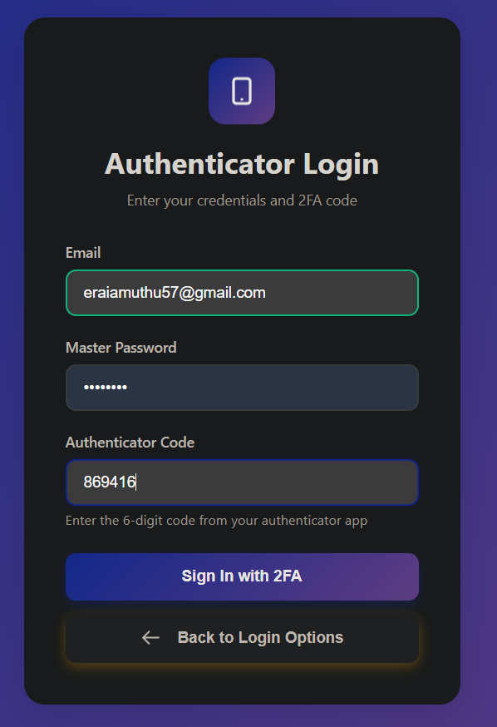
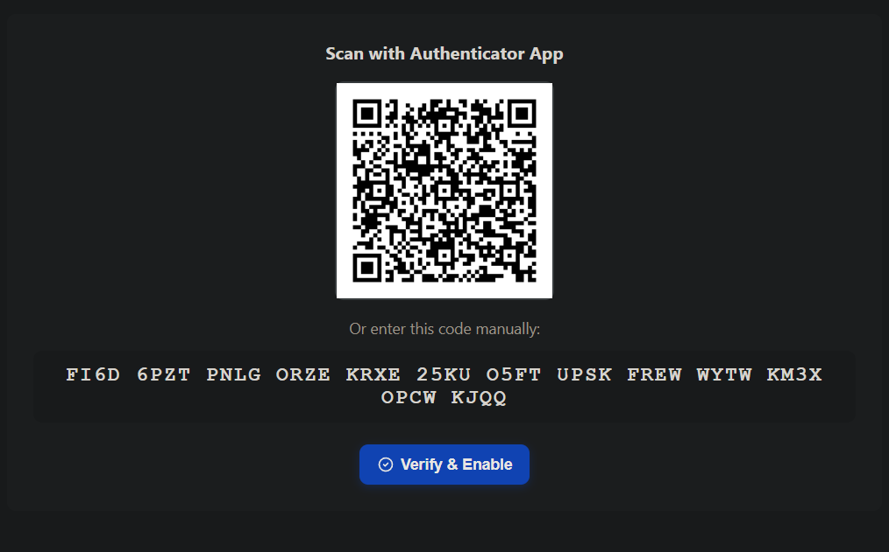
TOTP AUTHENTICATION

Slide 23
DATABASE DESIGN
03

Slide 24
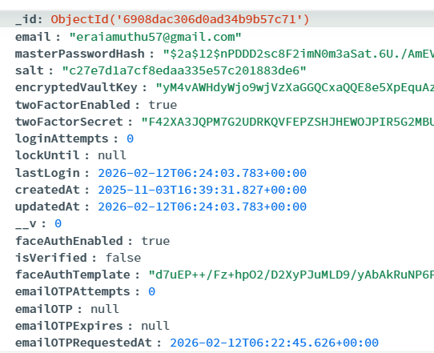
USER COLLECTION
Email
Hashed Password
Salt for PBKDF
Encrypted Vault Key
2FA Details
Face Data
OTP Details

Slide 25
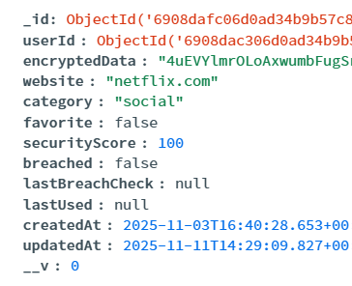
PASSWORD COLLECTION
Encrypted Data – AES 256
(Username + Password)
Website Info
Category
Security Score

Slide 26
SECURITY MEASURES
04

Slide 27
SECURITY MEASURES
Bcrypt password hashing
Encrypted vault storage
OTP verification
Rate limiting
Account lock mechanism
Secure HTTP headers

Slide 28
ADVANTAGES
Multiple authentication layers
Zero-knowledge encryption
AI-based face login
High privacy protection
Real-world security approach

Slide 29
UPCOMING ENHANCEMENTS
Risk-based login scoring
Device trust analysis
Behavioural Biometrics
Security Analysis
Real-Time Alerts

Slide 30
CONCLUSION
05

Slide 31
SUMMARY
Built a secure password manager
Implemented strong encryption
Ensured user privacy
Prevents user data from even when leaks and hacks occur

Slide 32
REFERENCES
[1] N. Provos and D. Mazières, “A future-adaptable password scheme,” Proceedings of the USENIX Annual Technical Conference, pp. 81–91, 1999.
[2] B. Kaliski, “PKCS #5: Password-Based Cryptography Specification (PBKDF2),” RSA Laboratories, 2000.
[3] F. Schroff, D. Kalenichenko, and J. Philbin, “FaceNet: A unified embedding for face recognition and clustering,” Proc. IEEE Conf. Computer Vision and Pattern Recognition (CVPR), pp. 815–823, 2015.
[4] S. I. Serengil and A. Ozpinar, “DeepFace: A lightweight face recognition framework,” Proc. IEEE Int. Conf. Innovations in Intelligent Systems and Applications (INISTA), pp. 1–6, 2021.
[5] D. M’Raihi, M. Bellare, F. Hoornaert, D. Naccache, and O. Ranen, “TOTP: Time-Based One-Time Password Algorithm,” IETF RFC 6238, 2011.
[6] National Institute of Standards and Technology (NIST), “Digital Identity Guidelines: Authentication and Lifecycle Management,” NIST Special Publication 800-63B, 2020.

Slide 33
THANK YOU!
Live Website: Website

